Slide 1
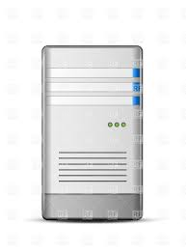




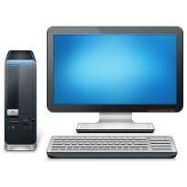


Remitter
eMoO Agent
Mobile Operator
eMoO Datacenter
Merchant
Beneficiary
Online PC
SMSC
SMS-GW
e-Voucher
Server
Web Server
E-Payer
Deposit
1
2
4
3
5
1
Transfer
2
3
4
2
1
3
4
5
Online
Payment
6
8
7
11
9
10

